Slide 1
Resume Classification using NLP
Mr. Hari Charan Bobbili
Ms. Panu Ingle
Mr. Jeevan G
Ms. Reethu T V
Mr. Surya Prakash Mangam
Ms. Megha V K

Slide 2




Agenda
Problem statement
Data Summary
Exploratory Data Analysis (EDA)
Model Building
Conclusion

Slide 3
Problem Statement
In today's competitive job market, recruiters are often flooded with hundreds, even thousands of resumes for a single position. Manually sorting through this volume of data is a time-consuming and error-prone process. This presentation will explore how machine learning can be used to automate resume classification, making the recruitment process faster and more efficient.

Slide 4
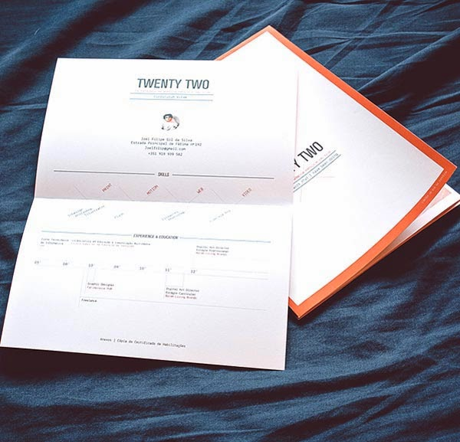
Data Summary
The dataset consists of 4 different categories of resumes: Peoplesoft, React & SQL Developers, and Workday.
This Photo by Unknown Author is licensed under CC BY-SA-NC

Slide 5
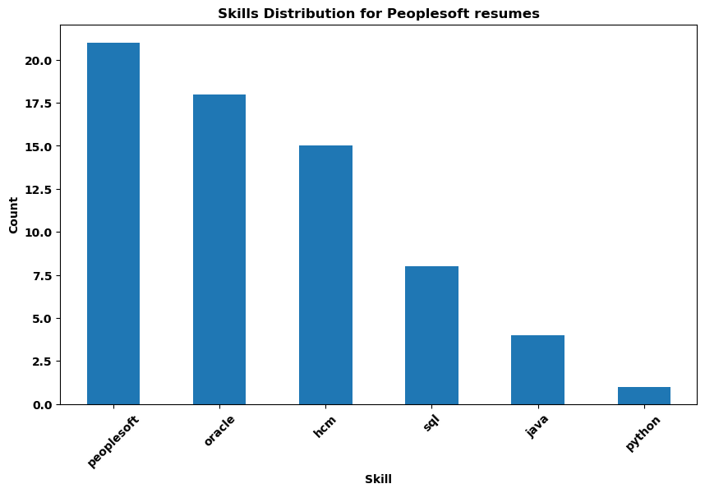
Exploratory Data Analysis (EDA)
Extracting all the skills from each category.
Major skills of Peoplesoft are peoplesoft, oracle, hcm, sql, java, python.
Skills of React Developer are react, Java script, java, angular, sql, oracle.
Skills of SQL Developer are SQL, python, oracle.
Skills of Workday are workday, hcm, peoplesoft, oracle, sql, fcm.

Slide 6
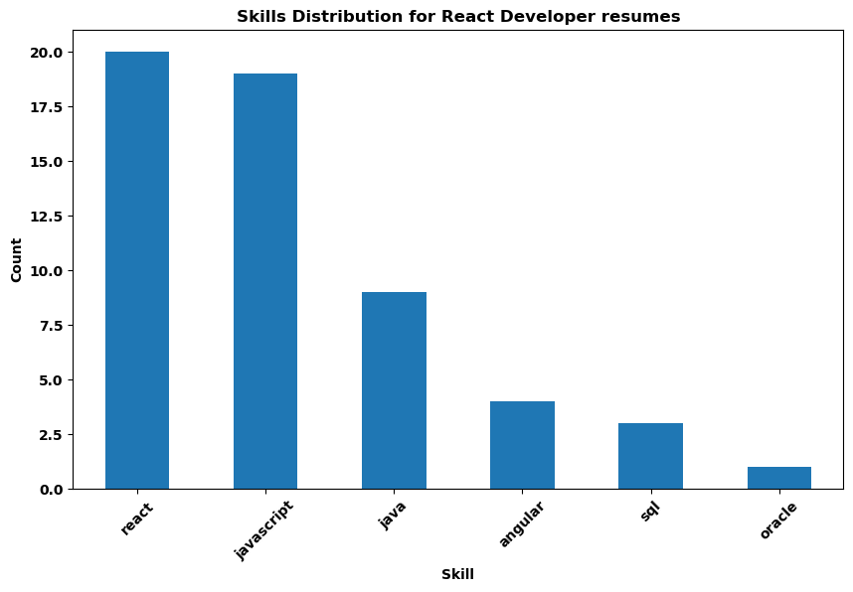
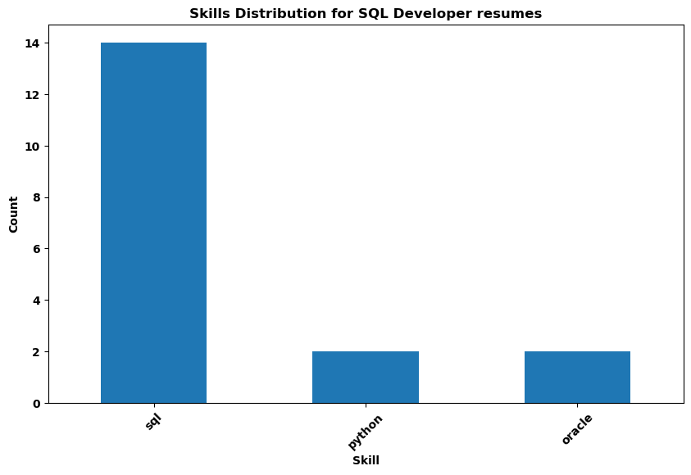
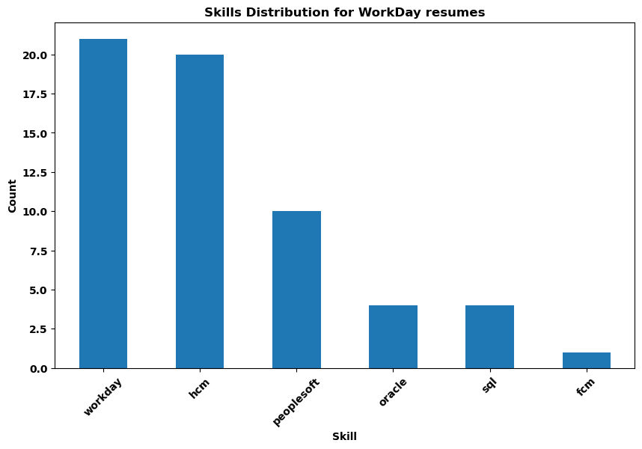
Exploratory Data Analysis(EDA)

Slide 7
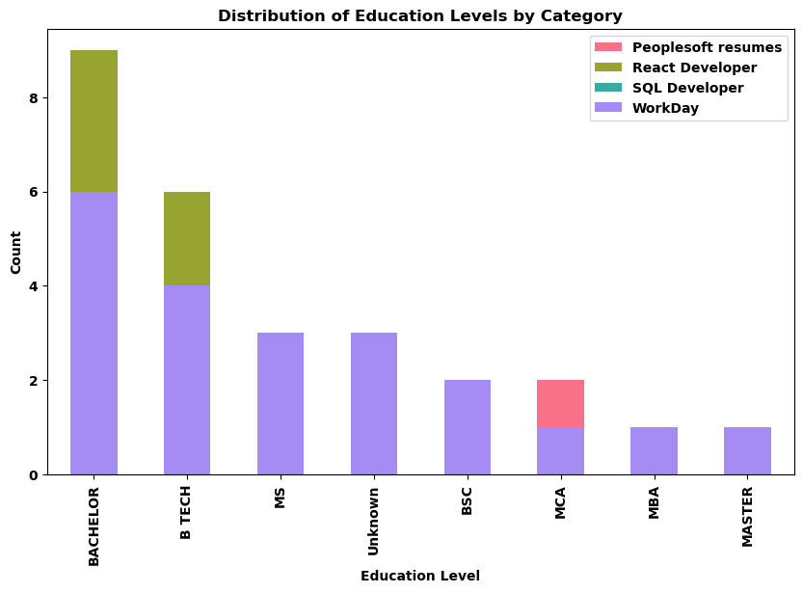
Exploratory Data Analysis (EDA)
Different types of education levels can be observed in each of category.
Types of education levels are Bachelor, B.Tech, MS, B.Sc, MCA, MBA, Master.

Slide 8
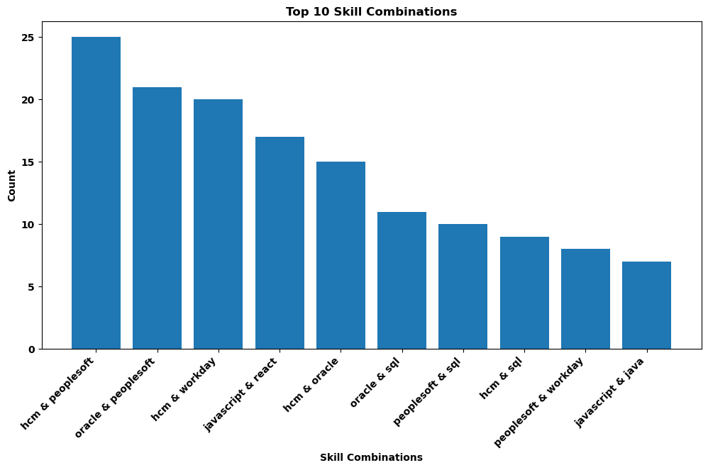
Exploratory Data Analysis (EDA)
These are the Top 10 Skill Combinations with the category.

Slide 9
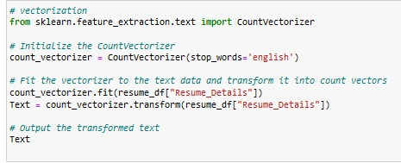
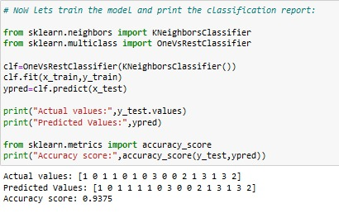
Model Building
For vectorization we have used tf-idf and count vectorizations.
We have used different type of models like KNN, Decision Tree, Naïve Bayes, SVM.
The combination of tf-idf vectorization with all models resulted in over-fitting.
So we choosed to build a model with COUNT vectorization and KNN classifier which gave accuracy of 93%.

Slide 10
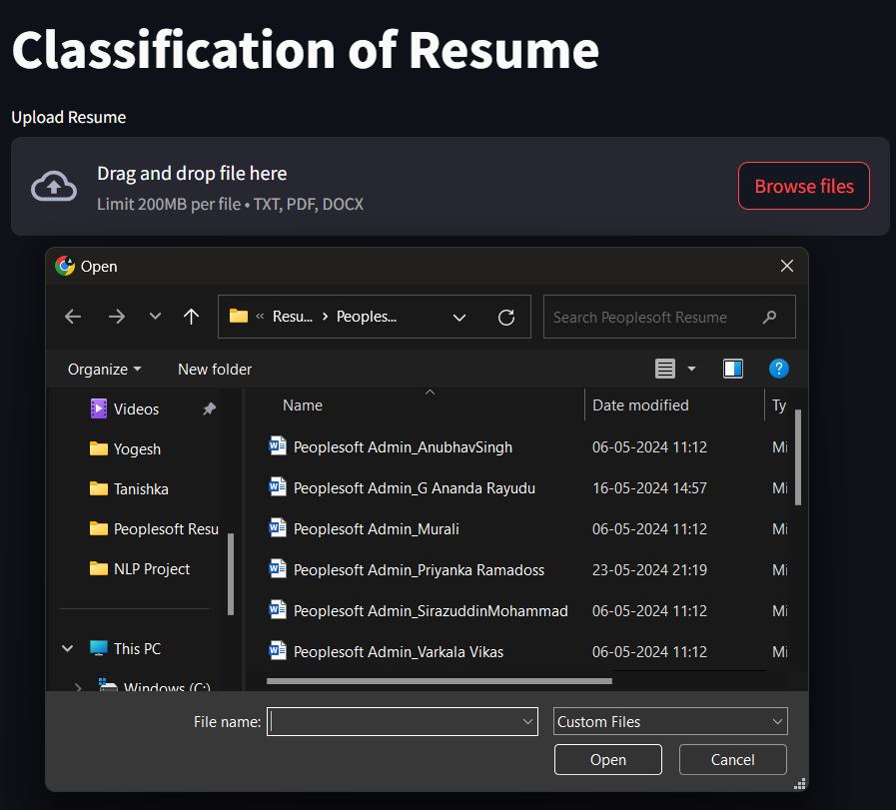
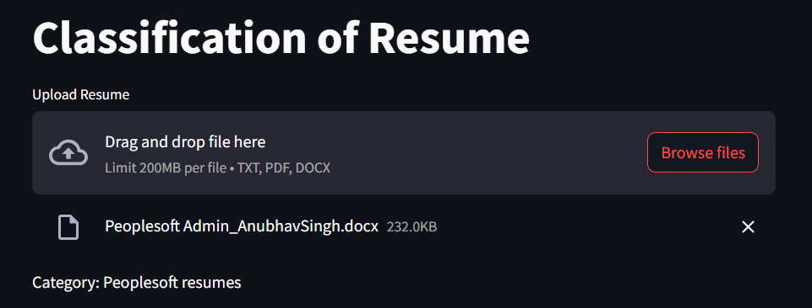
Deployment
Uploads a resume file.
Preprocesses the text for model compatibility.
Uses the loaded model to make predictions.
Displays the predicted job category on the web app.

Slide 11


Conclusion
Resume classification is a valuable tool for modern recruiters .
Saves time, improves accuracy, and reduces bias.
Enables data-driven decision making in the recruitment process
This Photo by Unknown Author is licensed under CC BY
This Photo by Unknown Author is licensed under CC BY-NC-ND

Slide 12
Thank you

